Slide 1
Inter-Computer Communications (Networking One)
Week 5 2 Network Topologies

Slide 2
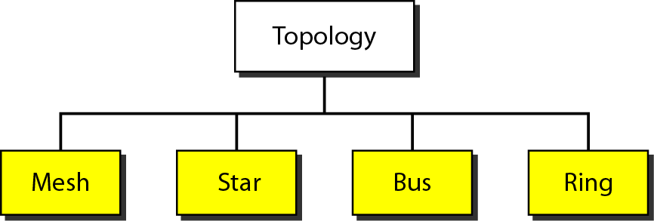
Categories of Topology
Network topology is the arrangement of the various elements (links, nodes, etc.) of a computer network.
Technically, it is the topological structure of a network and there are four basic topologies in this course.

Slide 3
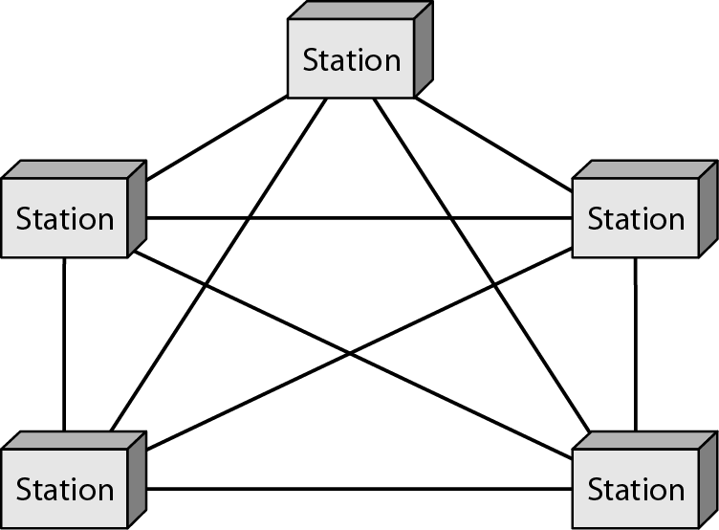
Mesh Topology
Every device has a dedicated point-to-point link to every other device.
The term dedicated means that the link carries traffic only between the two devices it connects.
To find the number of physical links in a fully connected mesh network with n nodes.

Slide 4
Mesh Topology
Advantages | Disadvantages
Mesh topology is robust. If one link becomes unusable, it does not cripple the entire system. | Every device must be connected to every other device, installation and reconnection are difficult.
There is an advantage of privacy or security. Physical boundaries prevent other users from gaining access to messages. | Bulk of the wiring can be greater than the available space (in walls, ceilings, or floors) can hold.
Finally, point-to-point links make fault identification and fault isolation easy. This facility enables the network manager to discover the precise location of the fault and aids in finding its cause and solution. | Expensive hardware are required. For example: One practical example of a mesh topology is the connection of telephone regional offices in which each regional office needs to be connected to every other regional office.

Slide 5
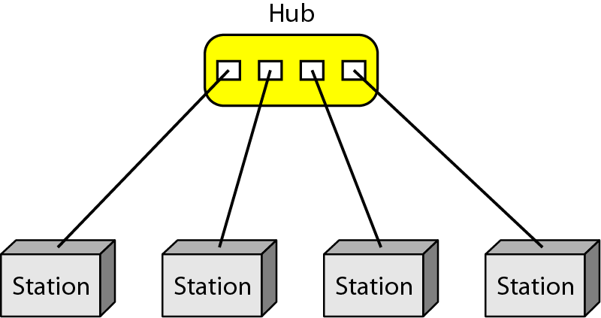
Star Topology
Each device has a dedicated point-to-point link only to a central controller, usually called a hub.
The devices are not directly linked to one another.
Unlike a mesh topology, a star topology does not allow direct traffic between devices.
The controller acts as an exchange: If one device wants to send data to another, it sends the data to the controller, which pass on data to the other connected device.

Slide 6
Advantages
Disadvantages
A star topology is less expensive than a mesh topology.
In a star, each device needs only one link and one I/O port to connect it to any number of others. This factor also makes it easy to install and reconfigure.
Less cabling needs to be housed, and additions, moves, and deletions involve only one connection: between that device and the hub.
Robustness is the major advantage. If one link fails, only that link is affected. All other links remain active.
As long as the hub is working, it can be used to monitor the link problems and bypass defective links.
A major disadvantage of a star topology is the dependency of the whole topology on one single point, the hub.
If the hub goes down, the whole system is dead.
A star topology requires less cable than a mesh, each node must be linked to a central hub. For this reason, more cabling is required in a star than in some other topologies (such as ring or bus).
The star topology is used in local-area networks (LANs).
High-speed LANs often use a star topology with a central hub.

Slide 7
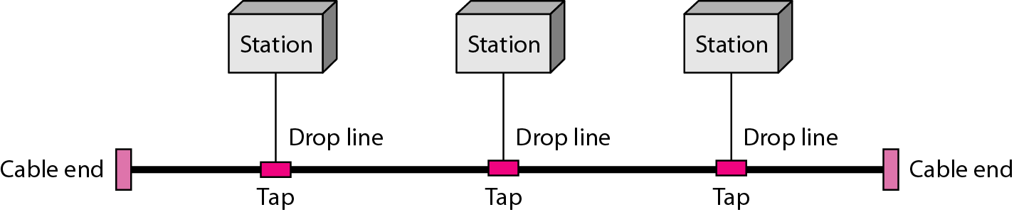
Bus Topology
Bus topology uses the idea of Multipoint in which a long cable acts as a backbone to link all the devices in a network.
A bus topology connecting three stations and nodes are connected to the bus cable by the drop lines and taps.
A drop line is a connection running between the device and the main cable.
A tap is a connector that either splices (unite) into the main cable or punctures the sheathing of a cable to create a contact with the metallic core.

Slide 8
Bus Topology
When a signal travels along the backbone, some of its energy is transformed into heat.
The signal becomes weaker and weaker as it travels farther and farther.
For this reason there is a limit on the number of taps a bus can support and on the distance between those taps.
Bus topology was the one of the first topologies used in the design of early local area networks.

Slide 9
Advantages
Disadvantages
Installation is much easier using this topology.
Backbone cable can be laid along the most efficient path.
A bus uses less cabling than mesh or star topologies.
In a star, 4 network devices in the same room require four lengths of cable reaching all the way to the hub. In a bus, this redundancy is eliminated. Only the backbone cable stretches through the entire facility. Each drop line has to reach as far as the nearest point on the backbone.
It is difficult in case of reconnection and fault isolation.
Signal reflection at the taps can cause degradation in quality, however, this can be controlled by limiting the number and spacing of devices connected to a given length of cable.
Adding new devices may require modification or replacement of the backbone.
A fault or break in the bus cable stops all transmission, even between devices on the same side of the problem.

Slide 10
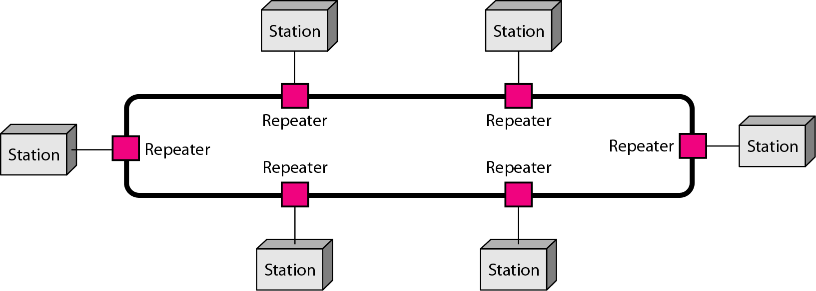
Ring Topology
A repeater
In ring topology, each device has a dedicated point-to-point connection with only two devices on either side of it.
A signal is passed along the ring in one direction, from device to device, until it reaches its destination.
Each device in the ring incorporates a repeater.
When a device receives a signal intended for another device, its repeater regenerates the bits and passes them along.

Slide 11
Advantages
Disadvantages
A ring is relatively easy to install and reconfigure.
Each device is linked to only its immediate neighbours (either physically or logically).
Only constraints are media and traffic considerations and the fault isolation is simplified.
Generally, a signal is circulating in the ring at all times. If one device does not receive a signal within a specified period, it can issue an alarm.
The alarm alerts the network operator to the problem and its location.
Unidirectional traffic is a major disadvantage.
In a simple ring, a break in the ring (such as a disabled station) can disable the entire network.
This weakness can be solved by using a dual ring or a switch capable of closing off the break.
Ring topology was popular when IBM introduced its local-area network Token (number of bits) Ring.

Slide 12
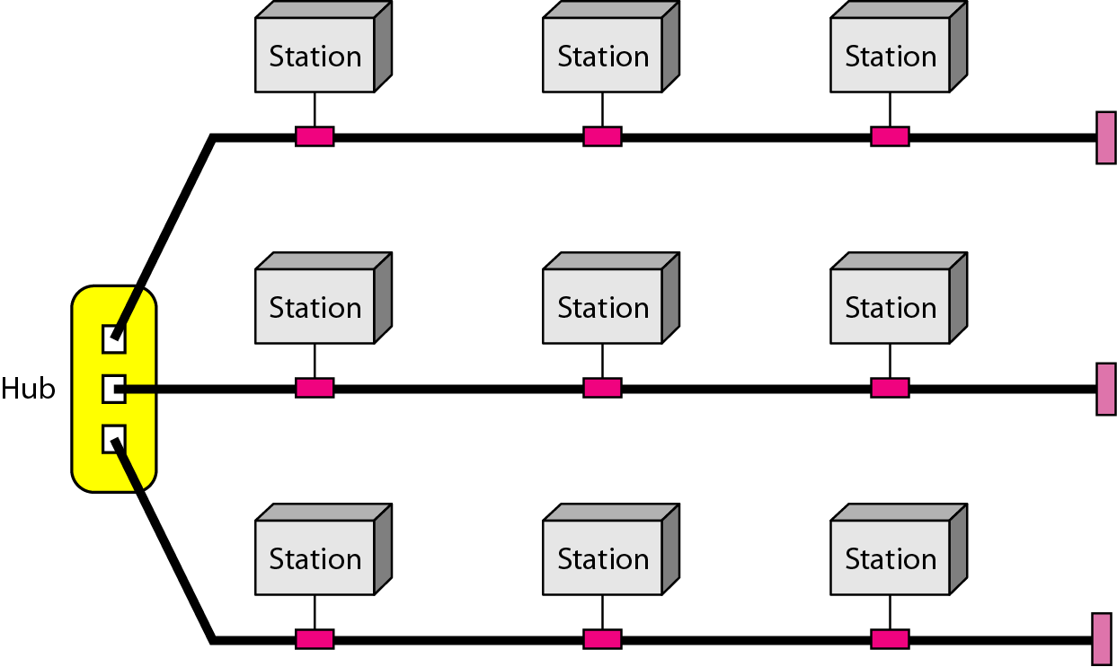
Hybrid Topology
Advantages
Figure:
A hybrid topology: a star backbone with three bus networks
Mesh: secure
Star: robust
Bus: easy installation
Ring: easy fault isolation
A Network Topology can be a hybrid depending on the need.
For example, we can have a main star topology with each branch connecting several stations in a bus topology as shown in Figure.

Slide 13
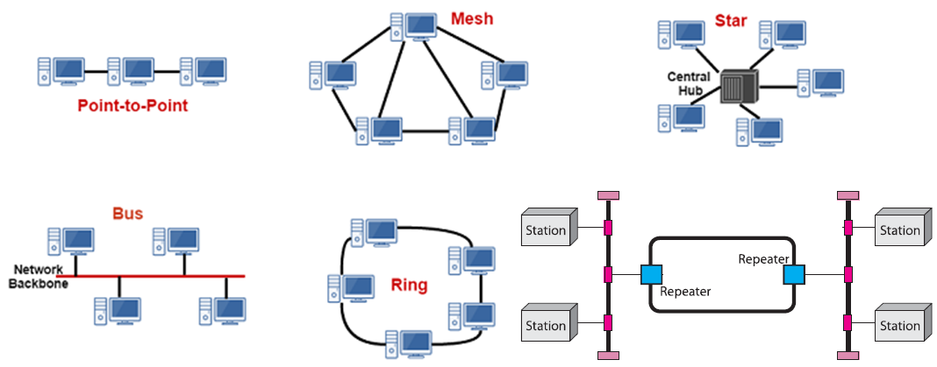
Topologies (Summary)
http://www.assignmenthelp.net

Slide 14
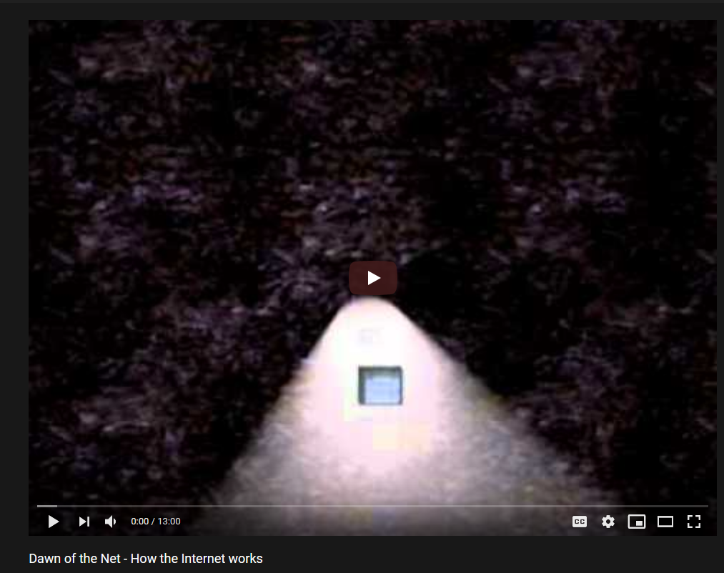
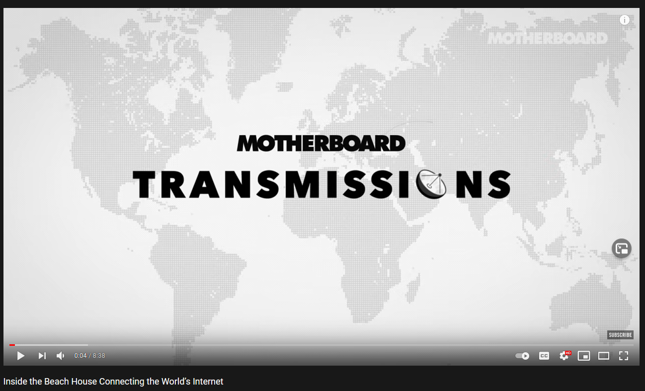
Link Break

Slide 15
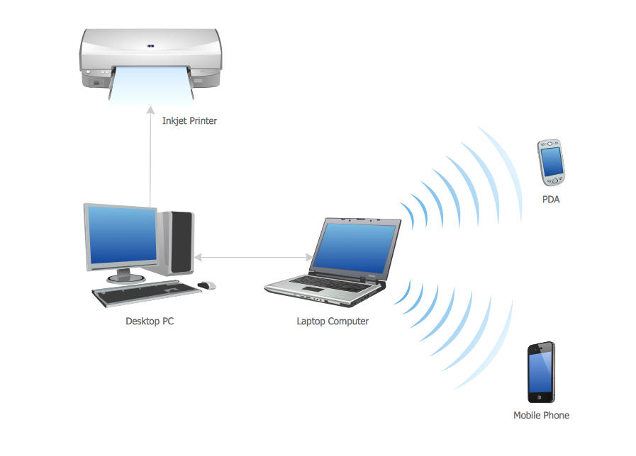
Personal Area Network
A personal area network (PAN) is a computer network used for data transmission amongst devices such as computers, telephones, tablets and personal digital assistants.
Connect devices over the range of a person.
Example of a Bluetooth (wireless) PAN.
https://en.wikipedia.org/wiki/Personal_area_network

Slide 16
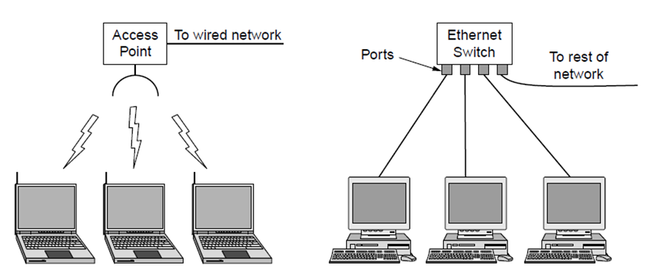
Local Area Network (LANs)
A Local Area Network (LAN) is privately owned and links the devices in a single office, building or campus.
LAN size is limited to a few kilometers and they are designed to allow resources to be shared between personal computers or workstations.
The resources to be shared can include hardware (e.g., a printer), software (e.g., an application program), or data.
One of the computers may become a server to clients.
The most common LAN topologies are bus, ring, and star. Early LANs had data rates in the 4 to 16 megabits per second (Mbps) range. Today, speeds are normally 100 or 1000 Mbps.
Wireless LAN
with 802.11
Wired LAN with
switched Ethernet

Slide 17
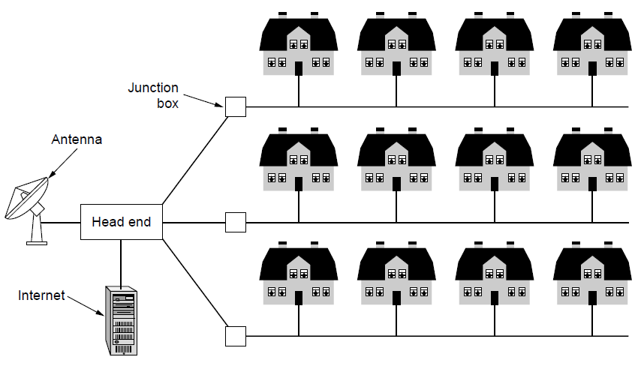
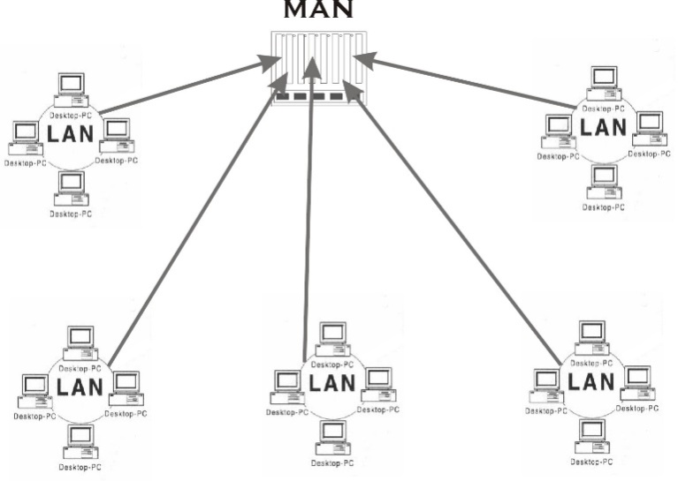
Metropolitan Area Networks (MAN)
Connect devices over a metropolitan area
Example MAN based on cable TV:
A metropolitan area network (MAN) is a network with a size between a LAN and a WAN.
It normally covers the area inside a town or a city.
Notes:
This is a common way in which home subscribers obtain access to the Internet in the US.

Slide 18
Metropolitan Area Networks (MAN)
It is designed for customers who need a high-speed connectivity, normally to the Internet, and have endpoints spread over a city or part of city.
A good example of a MAN is the part of the telephone company network that can provide a high-speed DSL (digital subscriber line) line to the customer.
Another example is the cable TV network that originally was designed for cable TV, but today can also be used for high-speed data connection to the Internet.

Slide 19
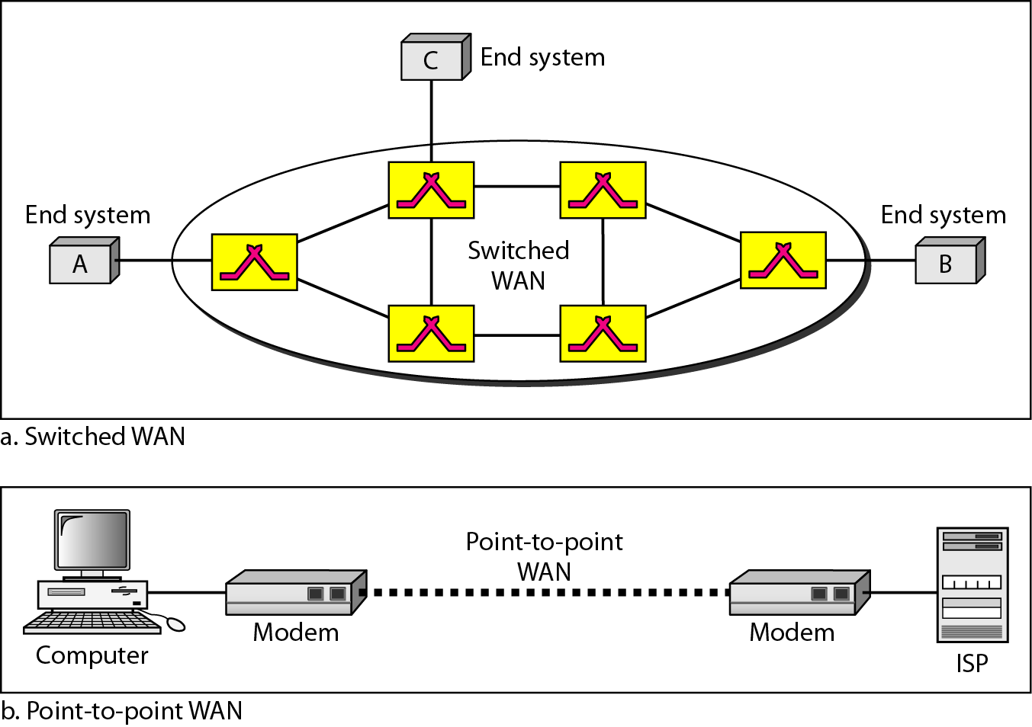
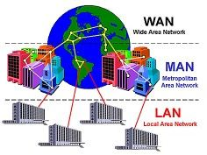
Wide Area Network (WAN)
A Wide Area Network (WAN) provides long-distance transmission of data, image, audio, and video information over large geographic areas that may comprise a country, a continent, or even the whole world.

Slide 20
Wide Area Network (WAN)
A WAN can be as complex as the backbones that connect the Internet or as simple as a dial-up line that connects a home computer to the Internet.
The switched WAN connects the end systems, which usually comprise a router (internetworking connecting device) that connects to another LAN or WAN.
The point-to-point WAN is normally a line leased from a telephone or cable TV provider that connects a home computer or a small LAN to an Internet service provider (lSP).
This type of WAN is often used to provide Internet access.
A good example of a switched WAN is the Asynchronous Transfer Mode (ATM) network, which is a network with fixed-size data unit packets called cells.

Slide 21
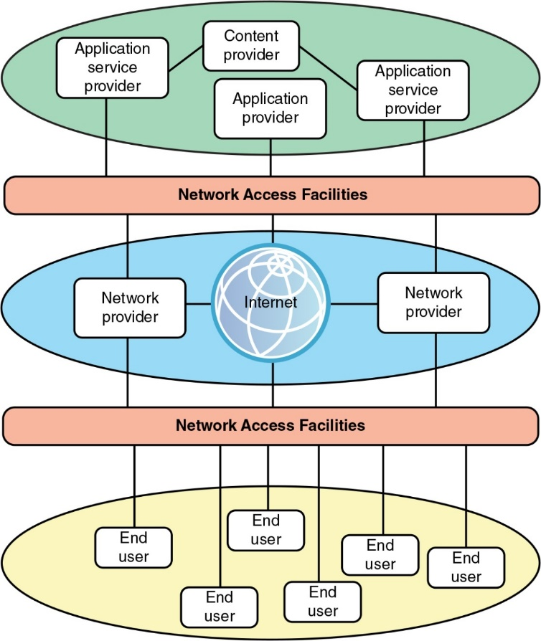
The Internet
The Internet has revolutionized many aspects of our daily lives. The Internet is a communication system that has brought a wealth of information to our fingertips and organized it for our use.
Reading of a newspaper from a distant city, or looked up a local movie schedule-all by using the Internet.
Researched a medical topic, booked a hotel reservation, chatted with a friend, or comparison-shopped for a car.
Notes:
Trekkie: a fan of the US science fiction television programme Star Trek.

Slide 22
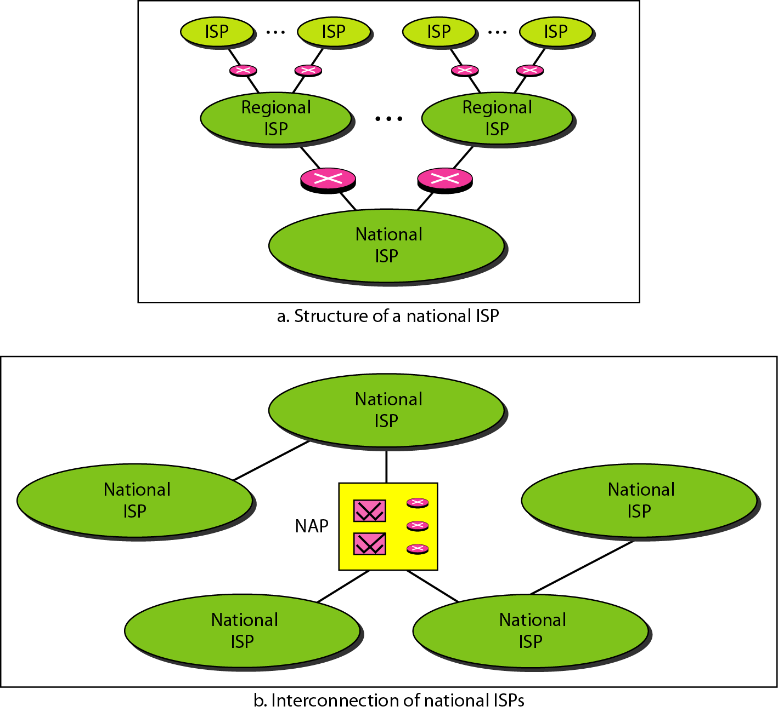
The Internet
Internet service providers
There are many national ISPs operating in North America; some of the most well known are SprintLink, PSINet, UUNet Technology, AGIS, and internet Mel.
To provide connectivity between the end users, these backbone networks are connected by complex switching stations called network access points (NAPs).
Some national ISP networks are also connected to one another by private switching stations called peering points. These normally operate at a high data rate (up to 600 Mbps).
Figure: Hierarchical organization of the Internet
What is major difference between Internet and Telephone Network?
Notes:
A telephone network is a connection oriented circuit switched network. This means that a connection must be established between the two endpoints. Bandwidth is reserved for this circuit.
The Internet is a connectionless packet switched network. This means that packets can be sent without following an established connection and bandwidth can be shared with other users.
In a telephone network, there is a dedicated connection established between the two end users and it is a fixed line and it has got a fixed monthly rental for the connection but call charges are extra based on the duration of the call and region(local or STD).
In case of Internet there is no dedicated connection but the all authorized users are connected to the network using a unique IP and the cost will be dependent on the data downloads being made.

